Slide 1
GREEDY ALGORITHMS
Minimum Spanning Trees

Slide 2
DIVIDE AND CONQUER (Review)
Computing n^{th} Fibonacci Number
Karatsuba Integer Multiplication
MergeSort
Strassen’s Matrix Multiplication
Fast Fourier Transform
Median
Today: New Topic

Slide 3
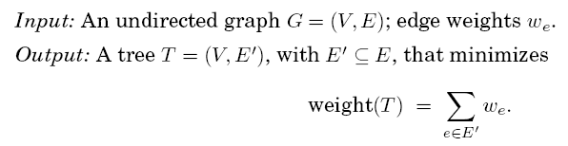
The MSP PROBLEM

Slide 4
EXAMPLE

Slide 5
A Greedy Approach
Kruskal’s Algorithm

Slide 6
Repeatedly add the next lightest edge that doesn't produce a cycle.
Start with an empty graph and do the above!

Slide 7
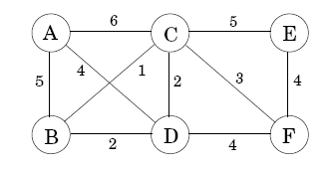
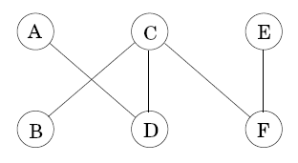
In Our Example…

Slide 8
Why Should It Always Work Correctly?
A Proof

Slide 9
The CUT Property

Slide 10
PROOF
Edges X are part of some MST T
Assume new edge e is not in T
We will construct a different MST T’ containing X U {e}
Add edge e to T, and this creates a cycle having another edge e’ b/w V and V-S

Slide 11
Proof (Contd.)
If we now remove this edge e’, we are left with T’ = T U {e} - {e’}, which we will show to be a tree

Slide 12
Proof (Contd.)
T’ is connected since e’ is a cycle edge.
And T’ has the same number of edges as T; so it is also a tree (Why?)

Slide 13
Proof (Contd)

Slide 14

Proof (Contd.)
Inference: KRUSKAL’s algorithm is correct.

Slide 15
Kruskal’s Algorithm (Textbook)
Complexity: |V| makeset, 2|E| find, and (|V| - 1) union operations.

Slide 16
Disjoint-Set Data Structure

Slide 17
The Operations
Rank is (say) the height of the sub-tree hanging from that node.

Slide 18
MERGING TWO SETS

Slide 19
Three Properties of Rank(x)
A root node with rank k is created by the merger of two trees with roots of rank (k-1). Induction follows!
This extends to internal (nonroot) nodes as well: a node of rank k has at least 2^{k} descendants. After all, any internal node was once a root, and neither its rank nor its set of descendants has changed since then.

Slide 20
Analysis (Contd.)
Makeset: O(1)
Find: O(log n)
Union: O(log n)
Overall: O((|E| + |V|)log |V|)
CAN WE DO BETTER?

Slide 21
PATH COMPRESSION
what if the edges are given to us sorted?

Slide 22
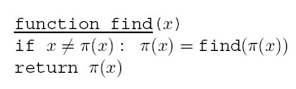
Modifying “find”
During each find, when a series of parent pointers is followed up to the root of a tree, we will change all these pointers so that they point directly to the root!

Slide 23
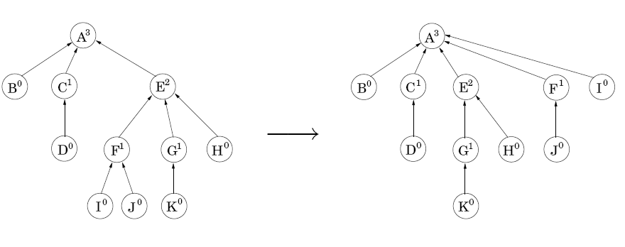
Example: find(I)

Slide 24

ANALYSIS
The time taken by a specific find operation is simply the number of pointers followed.
Ranks are divided into Intervals

Slide 25
Analysis (Contd.)
Nodes x on the chain (to root) fall into two categories:
either the rank of parent(x) is in a higher interval than the rank of x, or else
it lies in the same interval.
There are at most nodes of the first type

Slide 26
Analysis (Contd.)
Each time x is of the second type
its parent changes to one of higher rank.
therefore, if x's rank lies in the interval {k+1, … 2^{k}}, it is of this type at most 2^{k} times before its parent's rank is in a higher interval, whereupon it is never of the this (interval) second type again.
X
which
Since

Slide 27
THANK YOU Any Questions?
SUMMARY: Kruskal’s Algorithm using Disjoint-Sets data structure with path compression runs with the complexity of: “Sorting |E| elements” + O(|E| log*|V|)

